Slide 1
.NET of Things

Slide 2
This is:
This isn’t:
100 Level Overview
.NET
Electronics
Native C/C++
Anything Internet related

Slide 3
Word Cloud
C#
.NET Core
.NET Standard
UWP
Gadgeteer
.NET MicroFramework
TinyCLR OS
Meadow

Slide 4

Demo App
Based on outside light
Turn spaceship lights on or off
Constantly polling light sensor
Polling over I²C protocol

Slide 5
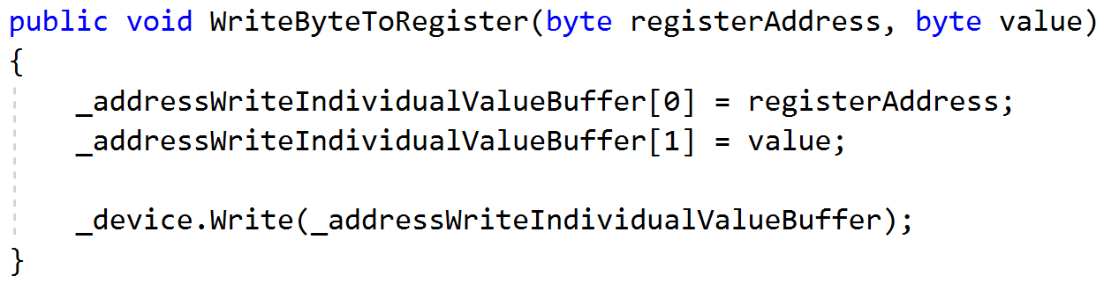
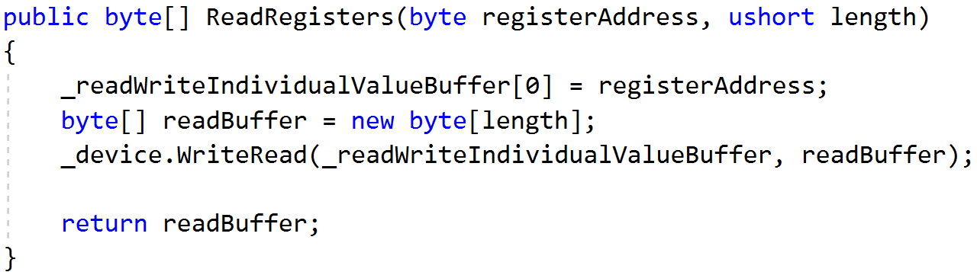
I²C Protocol
Eye Squared See
Synchronous Protocol
Requires Hardware Support
Message Process
Writing Data
Write Out Register
Write Out Each Byte
Reading Data
Write Out Register
Read Each Byte

Slide 6
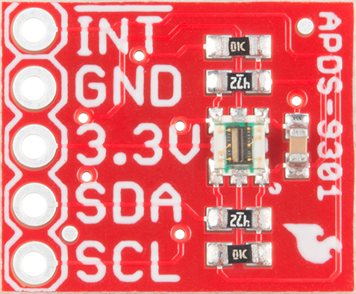
SparkFun Ambient Light Sensor
APDS-9301
https://www.sparkfun.com/products/14350

Slide 7
Raspberry Pi
“Low Resources”
1.4 GHz 64 bit ARM CPU
1 GB RAM
Pi 3 B+
Exposed Pins
The Money Maker

Slide 8
Three Options
Windows 10 IoT
Mono on Raspberry Pi
.NET Core on Raspberry Pi

Slide 9
Windows 10 IoT

Slide 10
Pros
Cons
Meh?
Amazing tooling
Top Tier Debugging
Line-by-Line
Remote over USB (or network???)
No Generics Support
Required updates every few years

Slide 12
.NET Core on Raspbeery Pi

Slide 13
Pros
Cons
Meh?
Amazing tooling
Top Tier Debugging
Line-by-Line
Remote over USB (or network???)
Still preview after a few years
Required updates every few years

Slide 15
.NET MicroFramework
Legacy
Designed for MCUs
RAM ~300KB
CPU like Cortex-M3 @ 120 MHz
Limited in features
No generics
Limited MCU selection
Open Source
http://netmf.github.io/
Netduino 2 courtesy of https://www.wildernesslabs.co/

Slide 16
Cons
Limited Language Feature Support
No Generics
Required VS Extension to begin
Only worked on Community Version of VS
Maxed out at VS 2015

Slide 17
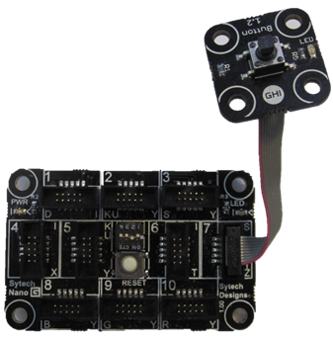
Gadgeteer
Extension of .NET MicroFramework
Easy Prototyping Platform
Expensive
Open Source
https://archive.codeplex.com/?p=gadgeteer
GHIElectronics FEZ Hydra
with Button module

Slide 20
TinyCLR OS
Created by GHI Electronics
https://www.ghielectronics.com/tinyclr/features
Can be ported to custom hardware
Modules hosted on NuGet
Not open source
Though documentation is
Supports native C/C++ code
No Generics Support

Slide 21
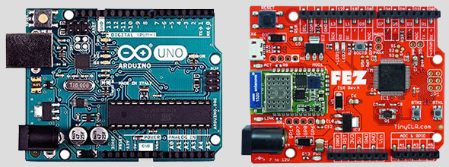
FEZ Board
Fast and Easy
Arduino Pin Compatible
$10 – Lowest Price
ARM Cortex-M4
512 KByte flash
96 KByte SRAM

Slide 22
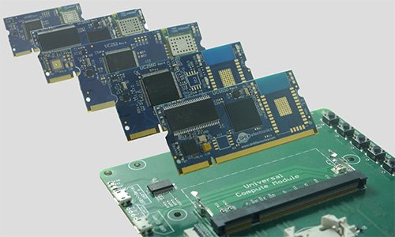
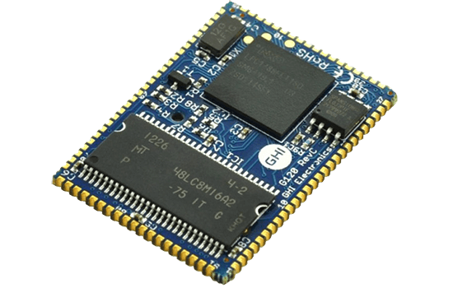
Other GHI Boards/Offerings
Universal Compute Modules
Meant for Prototyping or low volume devices
Switch out module while working
SurfaceMount Compute Modules
Modules solder to board
84MHz to 400 MHz chips
UCM
G120 SCM

Slide 23
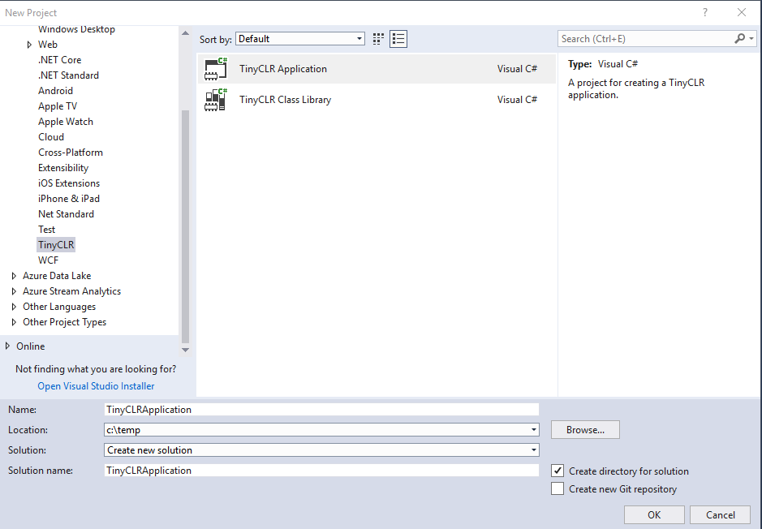
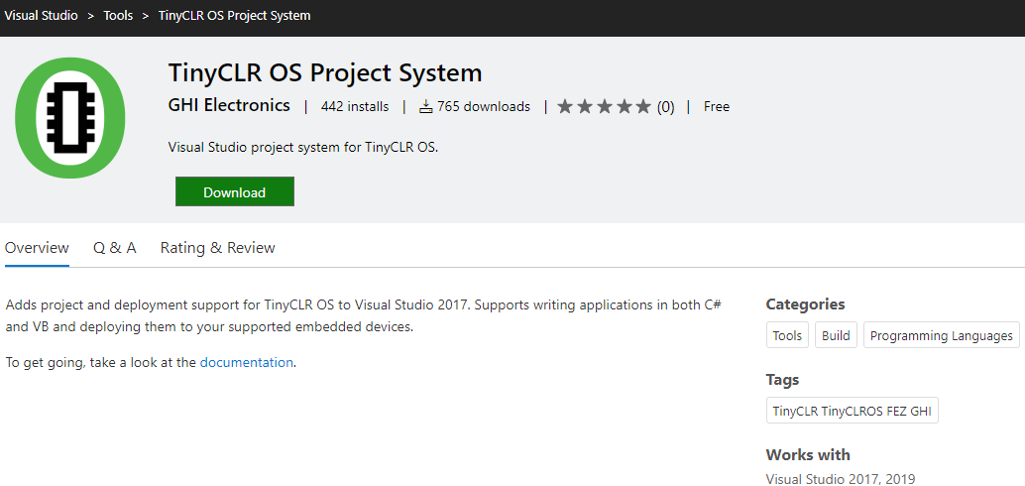
TinyCLR OS – Getting Setup
Follow simple instructions online
https://docs.ghielectronics.com/software/tinyclr/getting-started.html
Install “TinyCLR OS Project System” Extension to VS
https://marketplace.visualstudio.com/items?itemName=ghielectronics.tinyclr-projectsystem
Create new project

Slide 24
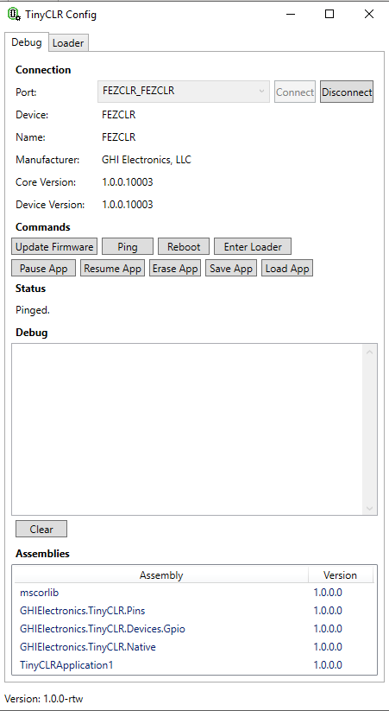
TinyCLR Config
Application to update device Firmware
Debug board
Might need this on first use of new board

Slide 25
Pros
Cons
NuGet Packages
Line-by-Line Debugging
Win10 IoT API
No Generics Support
Can’t reference .NET Standard Libraries
Use Threads, not Tasks

